Slide 1
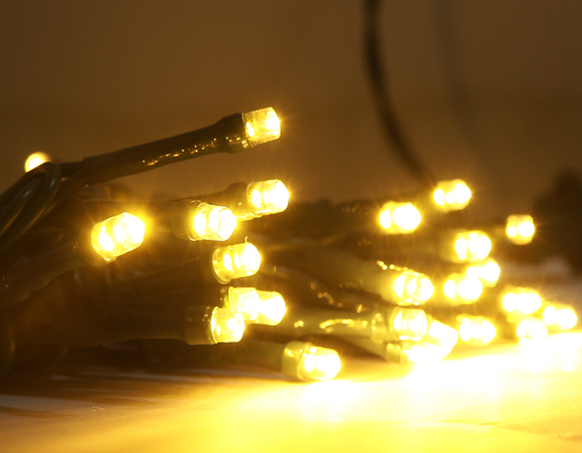
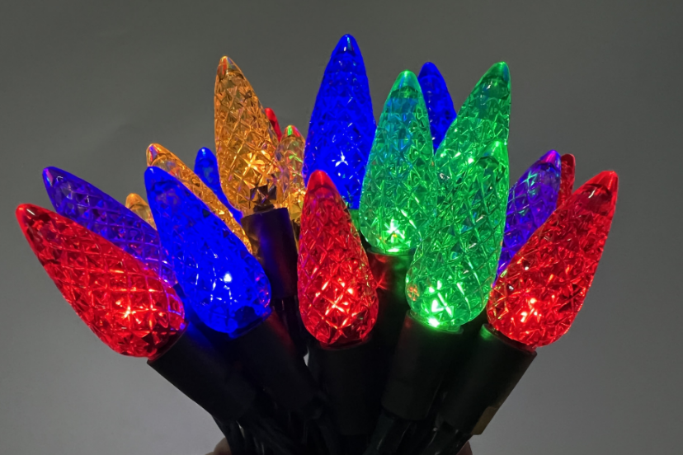
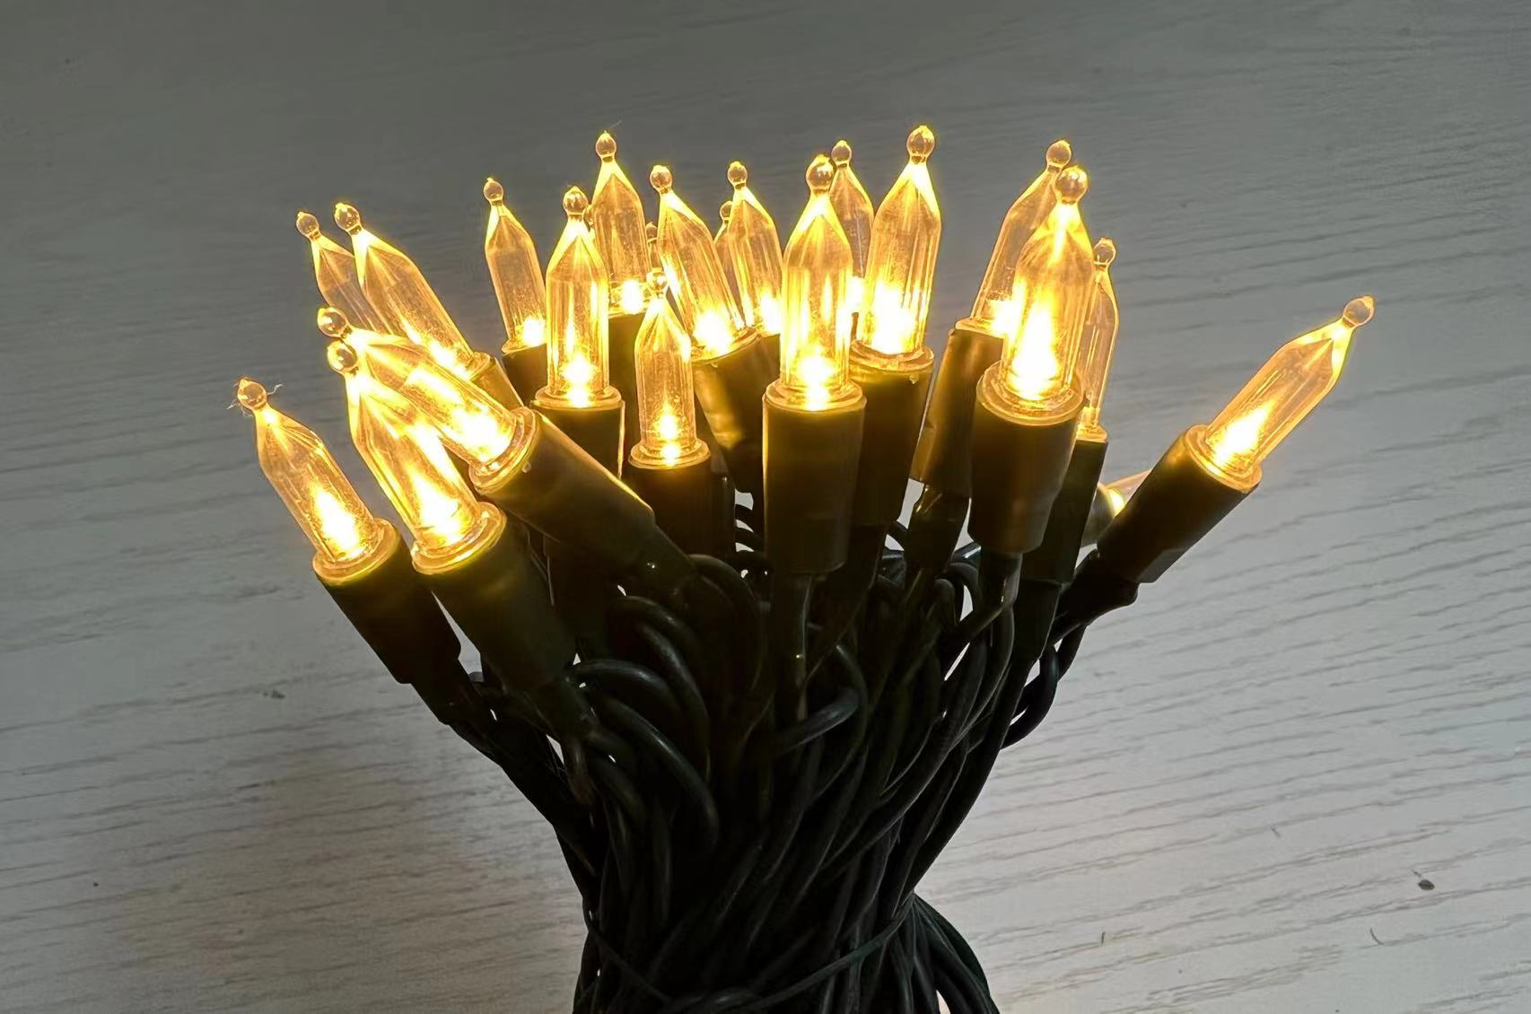
Non-replaceable LED
GOLDEN VESSEL

Slide 2
specification
Décor Cover
LED Color: White or Multi
LED Size: 3MM or 5MM Concave
Wire Color: Green, White
LEDs: 35,50,70,100,150,200
LED spacing:4”(10cm)
Lead in/out: 24”(60cm)/4”(10cm)
IP44,Ind&Outdoor use
UL plug
Steady On
*Concave 5mm
*Smooth mini(2 options)
*Faceted mini
*Faceted G12
*Faceted C6
*Faceted C7&C9
*Ceramic C7 &C9

Slide 3
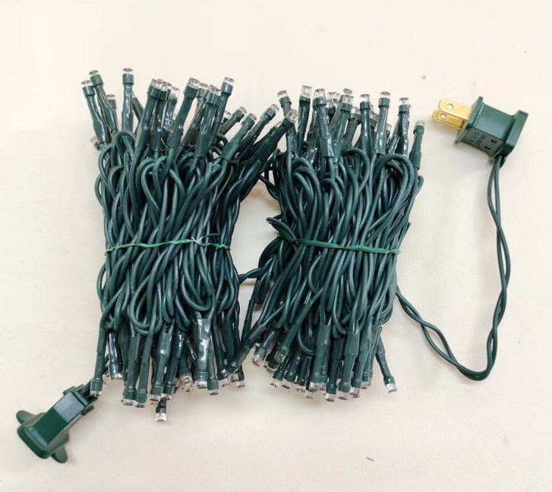
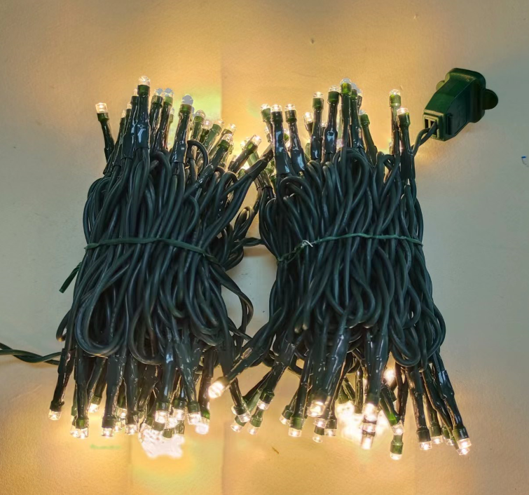
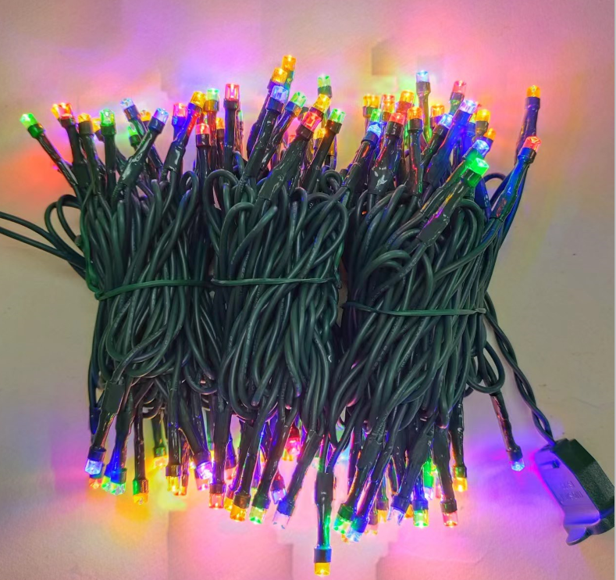
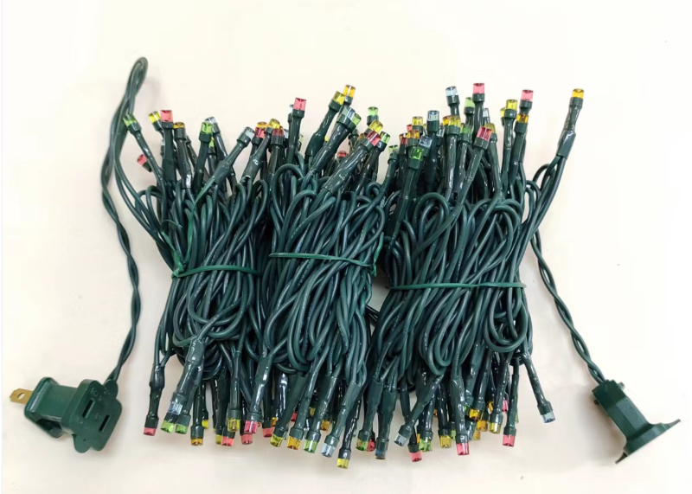
Concave 5mm
T-100C/2F-M5
T-100B/2F-M5

Slide 4
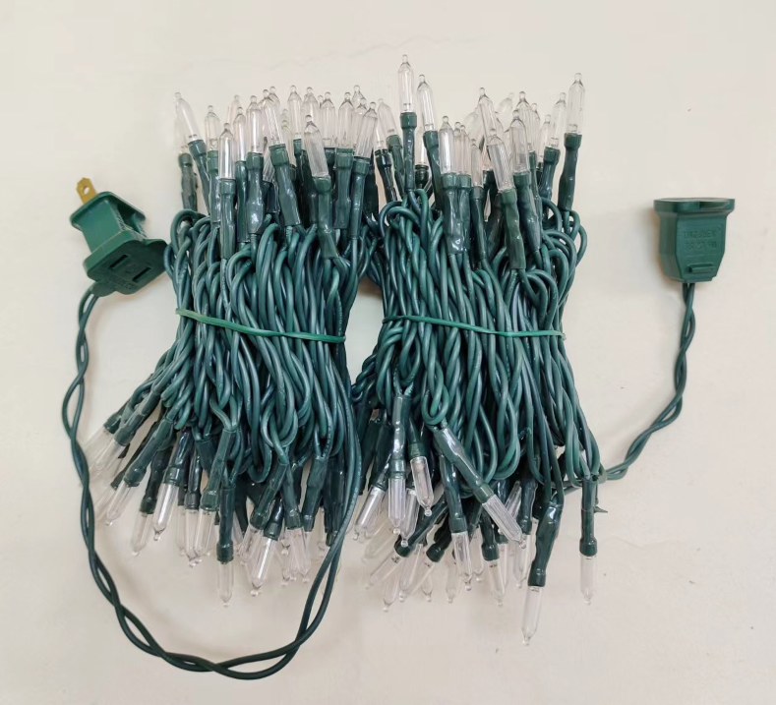
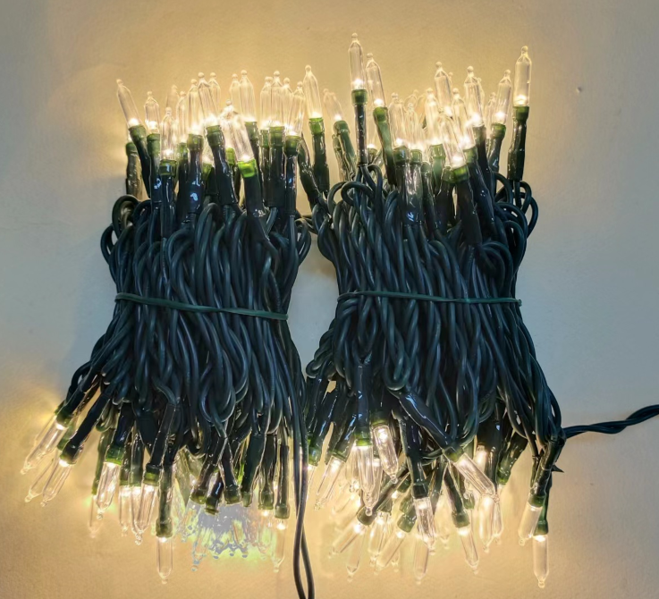
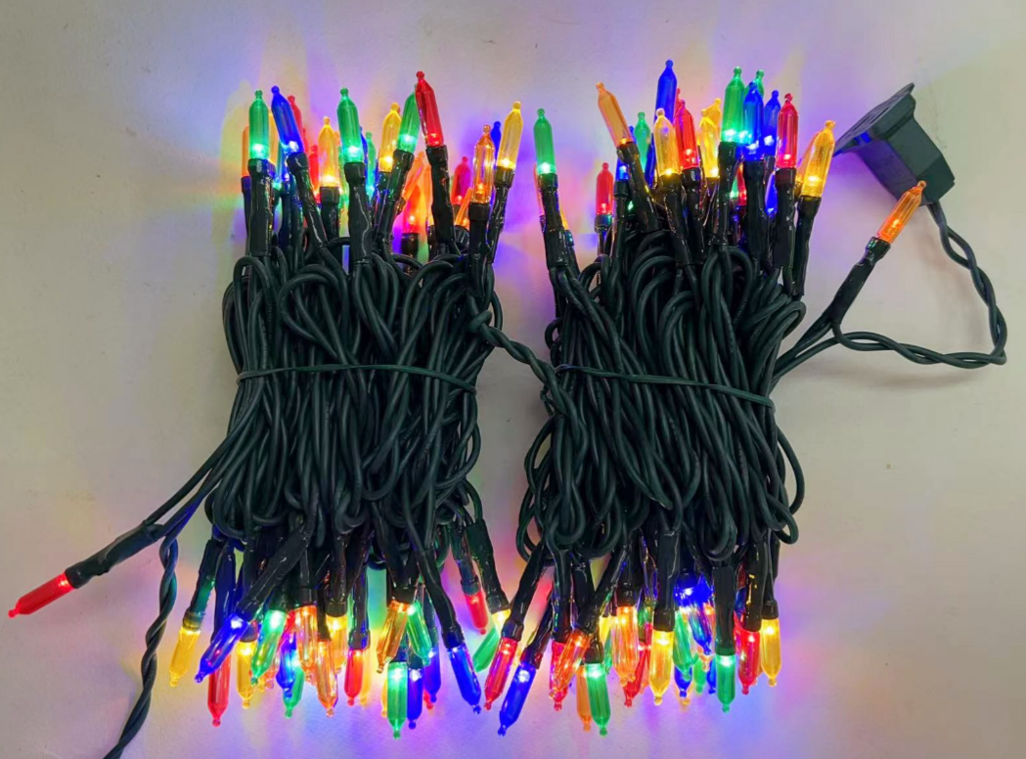
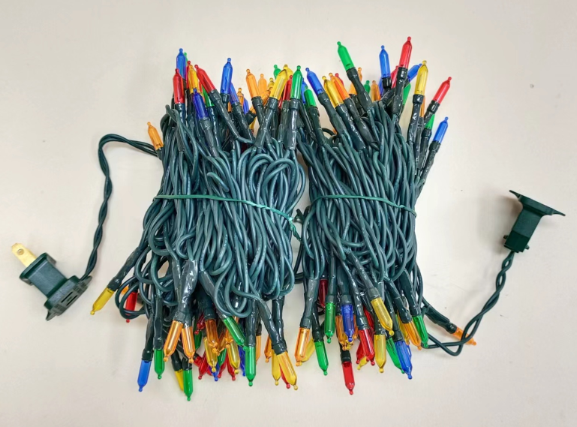
Smooth mini
T-100C/2F-A45
T-100B/2F-A45

Slide 5
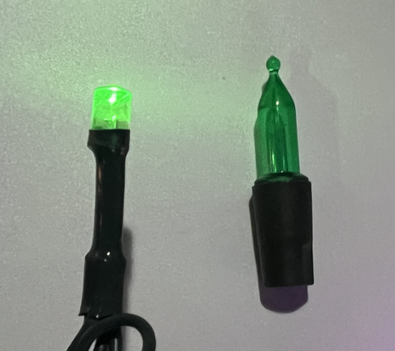
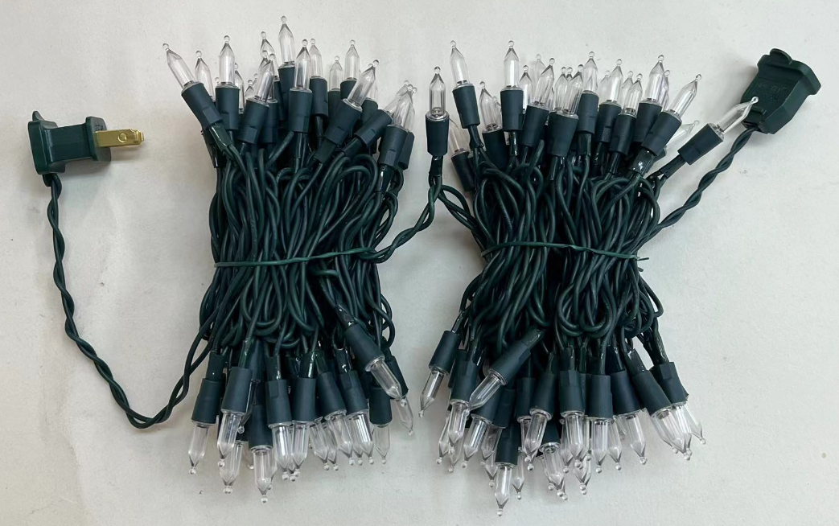
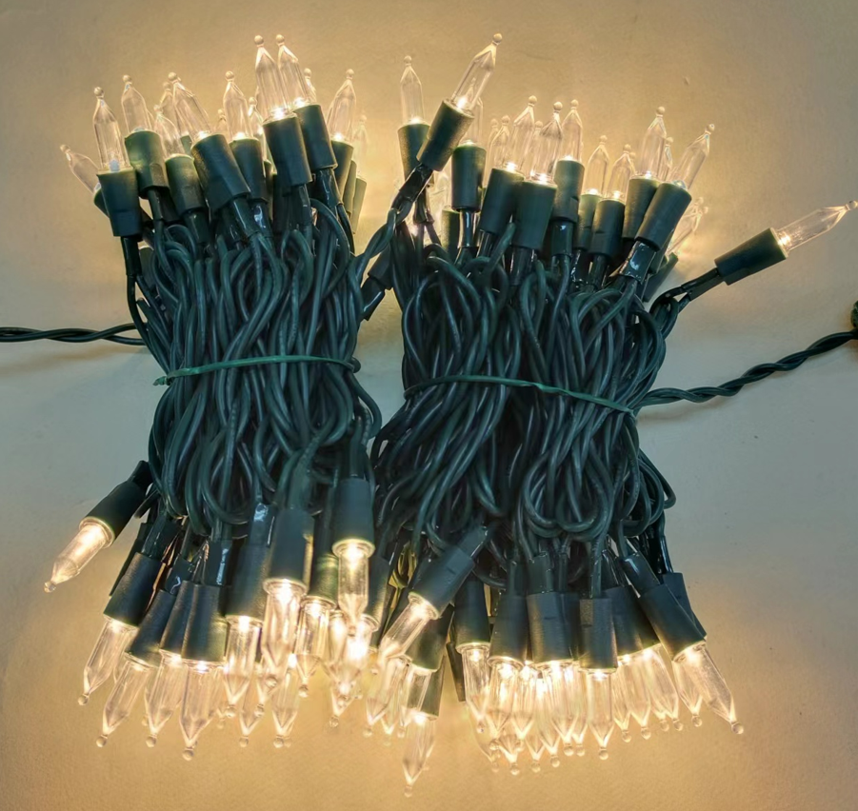
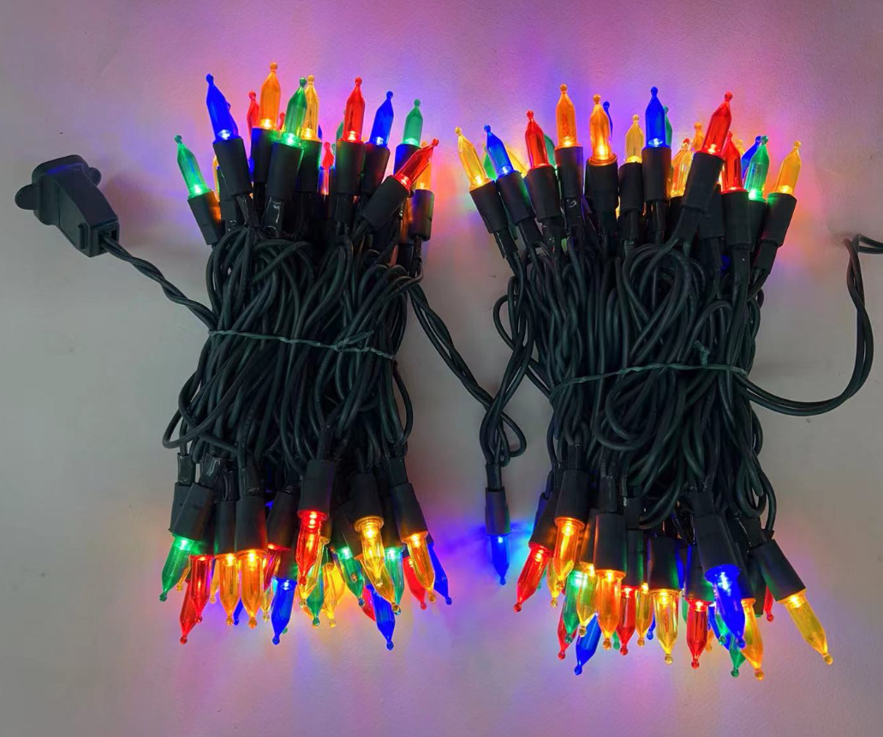
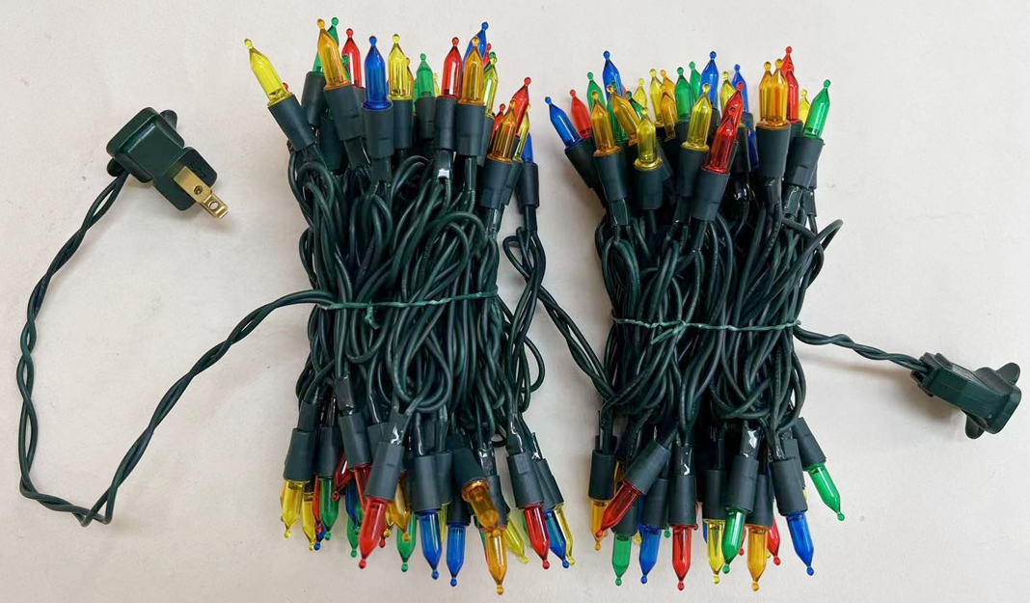
Smooth mini
T-100C/2F-A45S
T-100B/2F-A45S

Slide 6
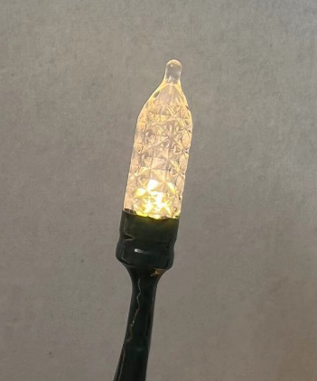
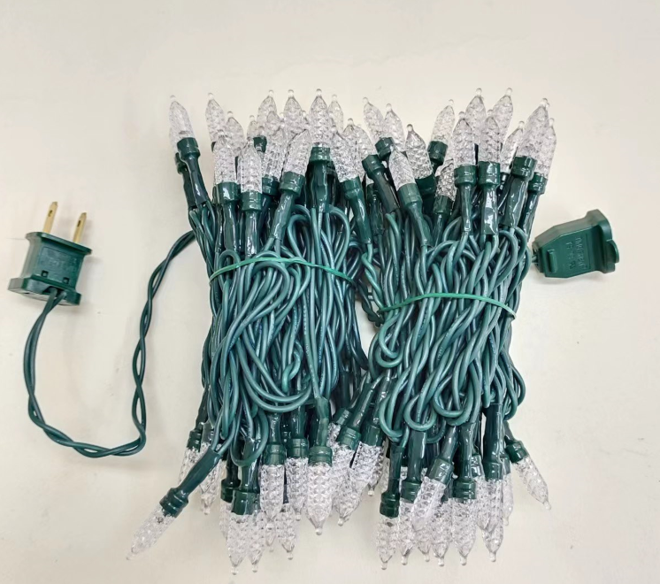
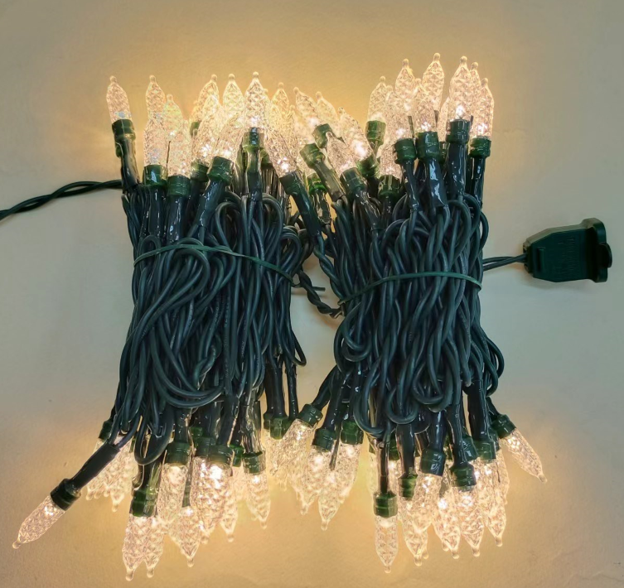
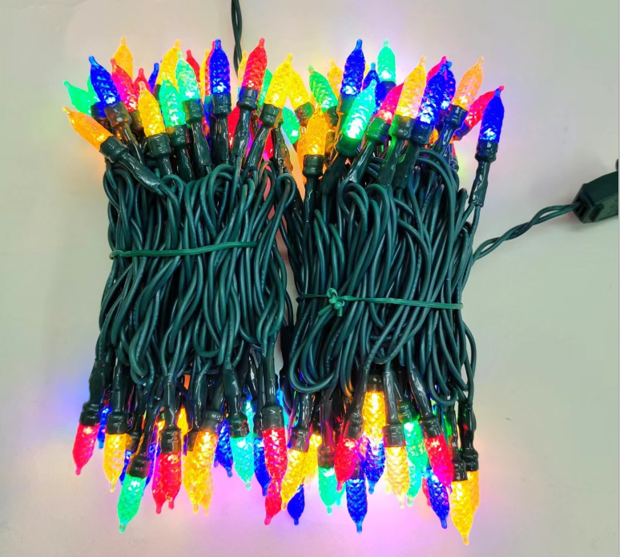
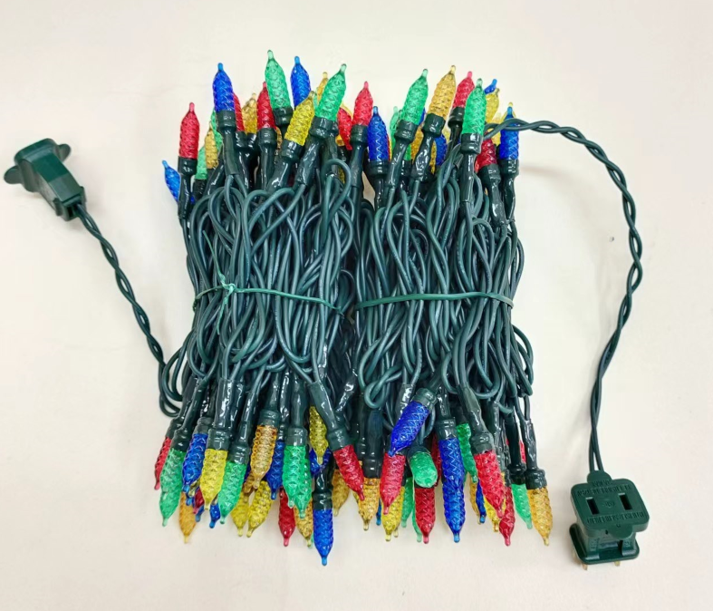
Faceted mini
T-100C/2F-7mm
T-100B/2F-7mm

Slide 7
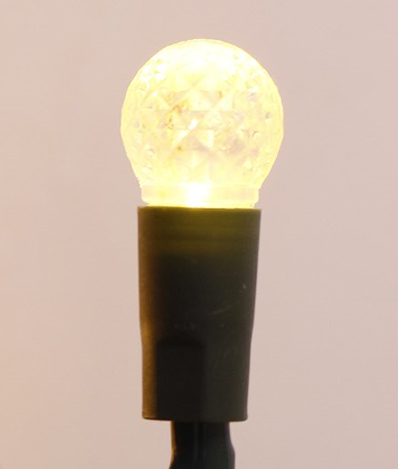
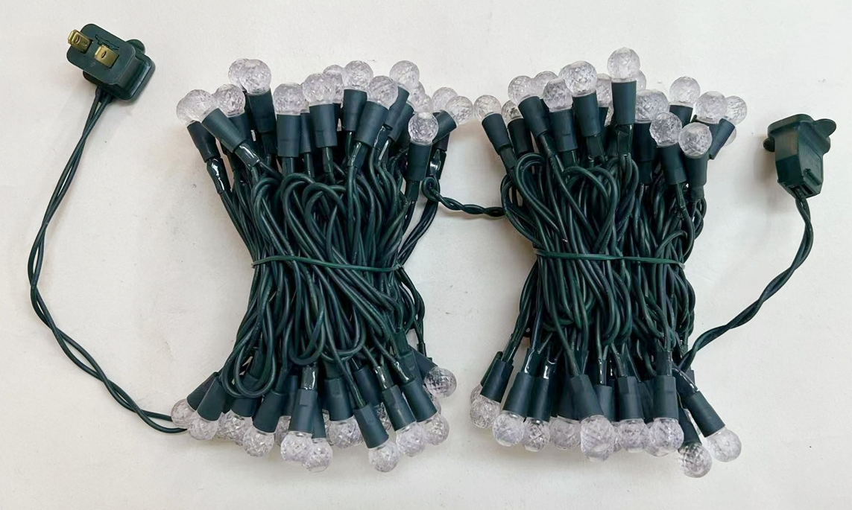
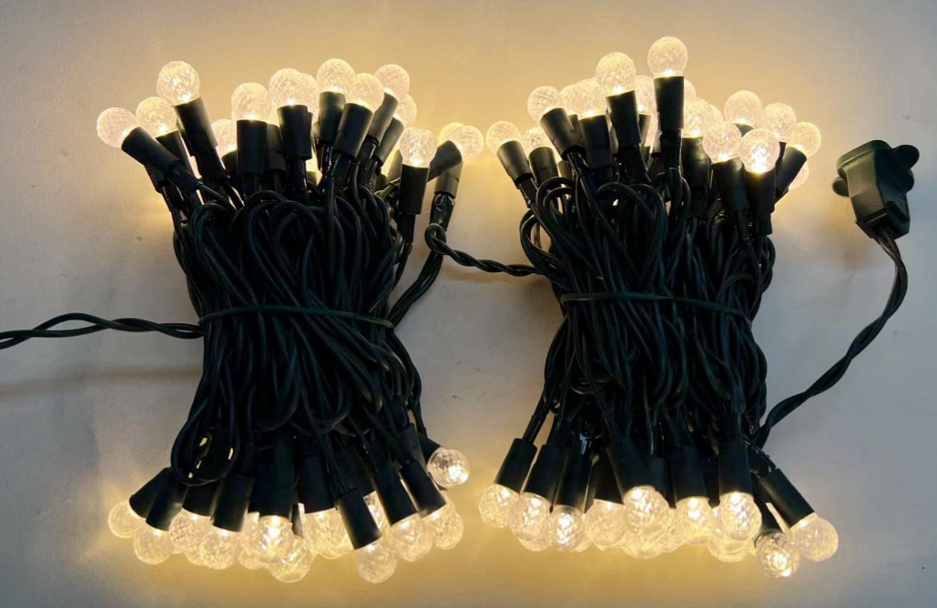
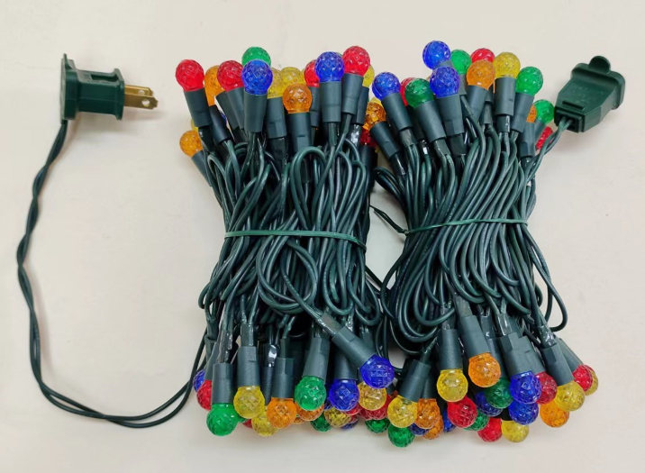
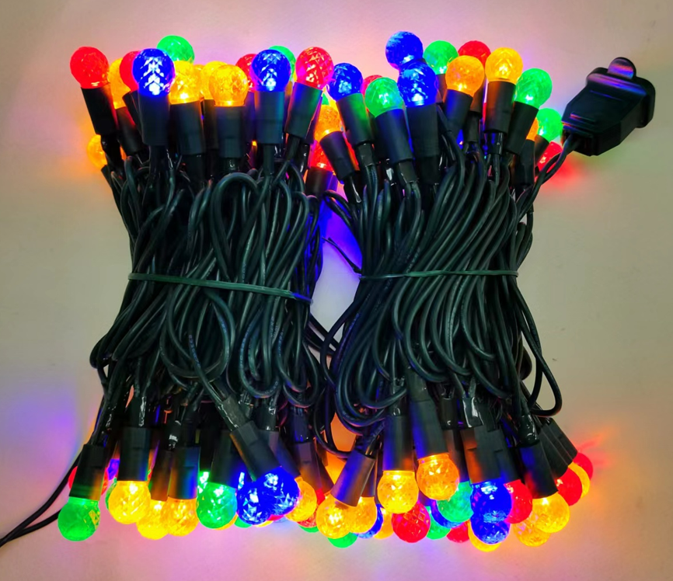
Faceted G12
T-100C/2F-G12
T-100B/2F-G12

Slide 8
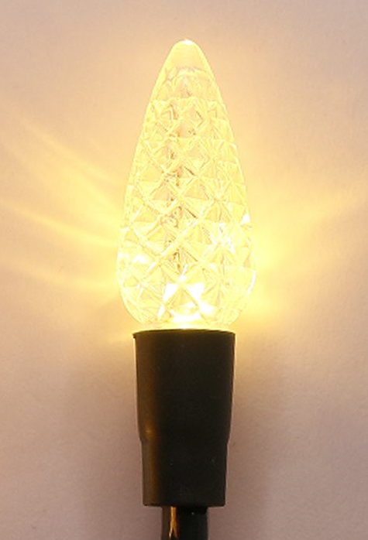
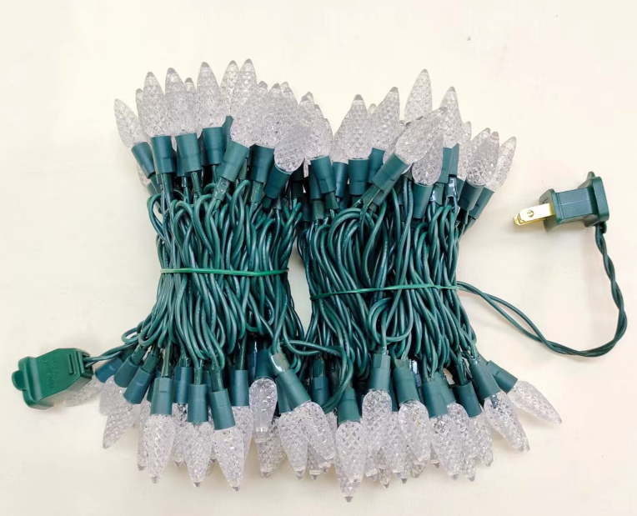
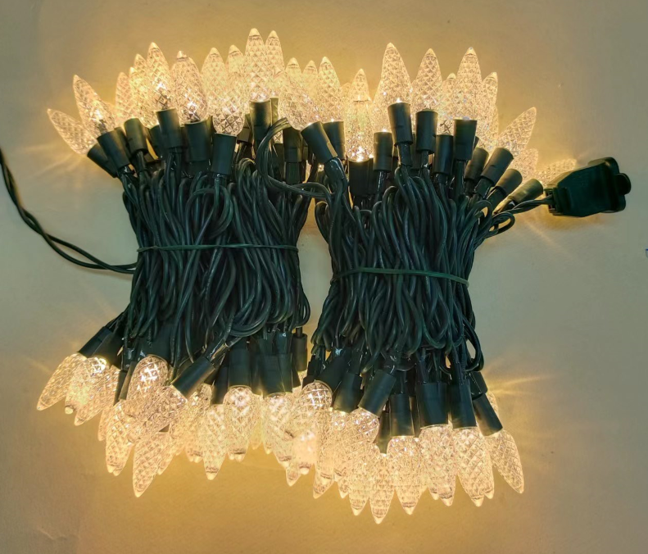
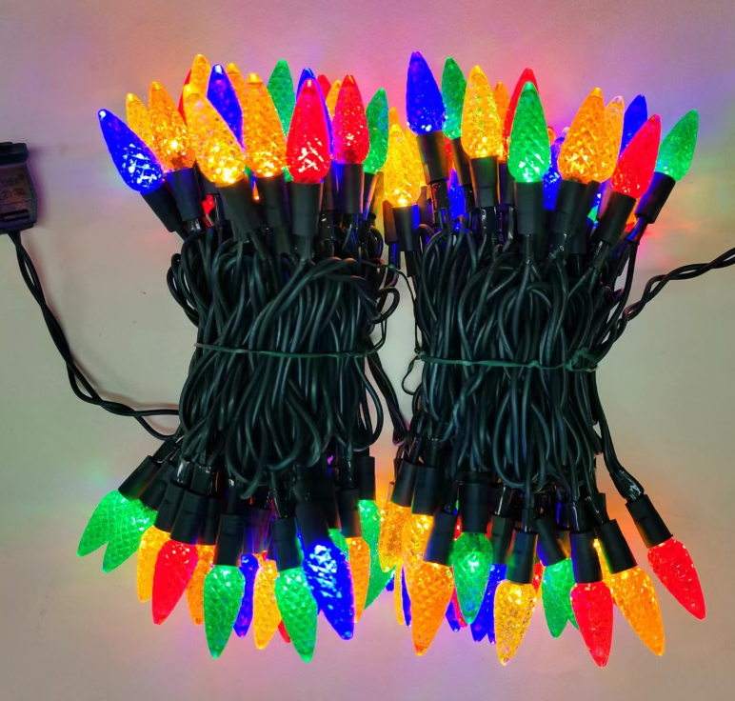
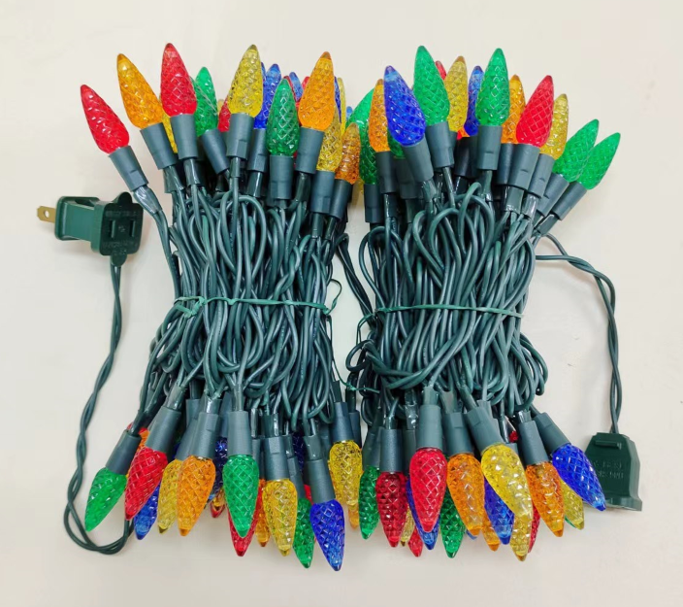
Faceted C6
T-100C/2F-C6
T-100B/2F-C6

Slide 9
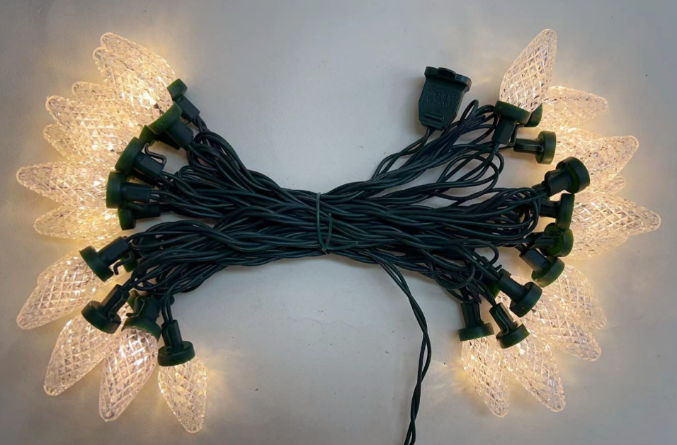
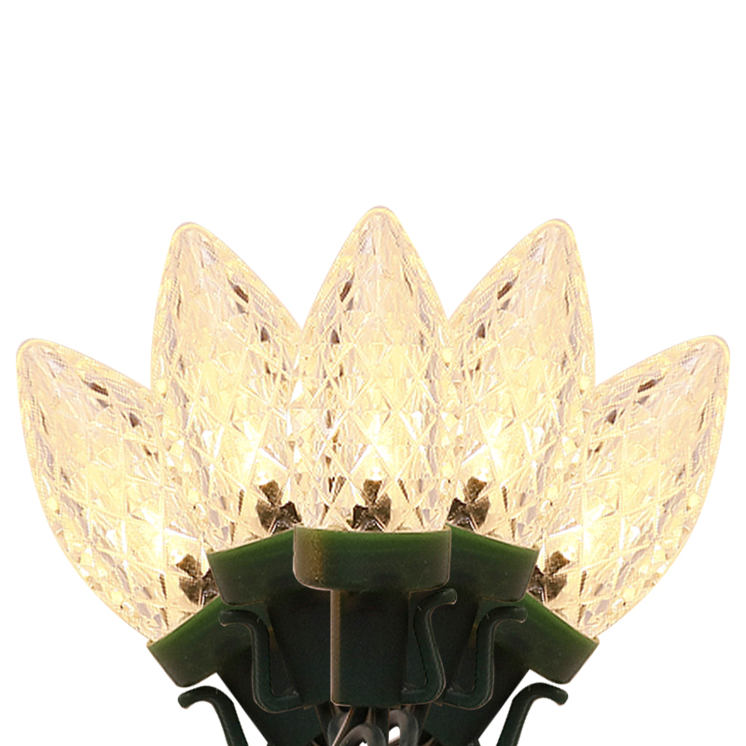
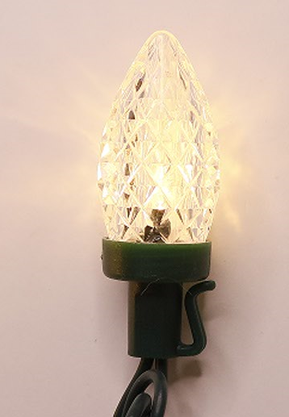
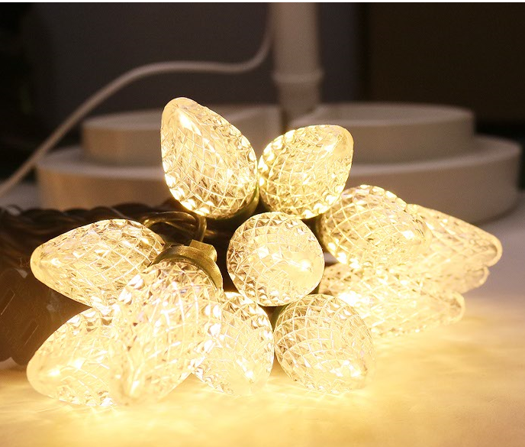
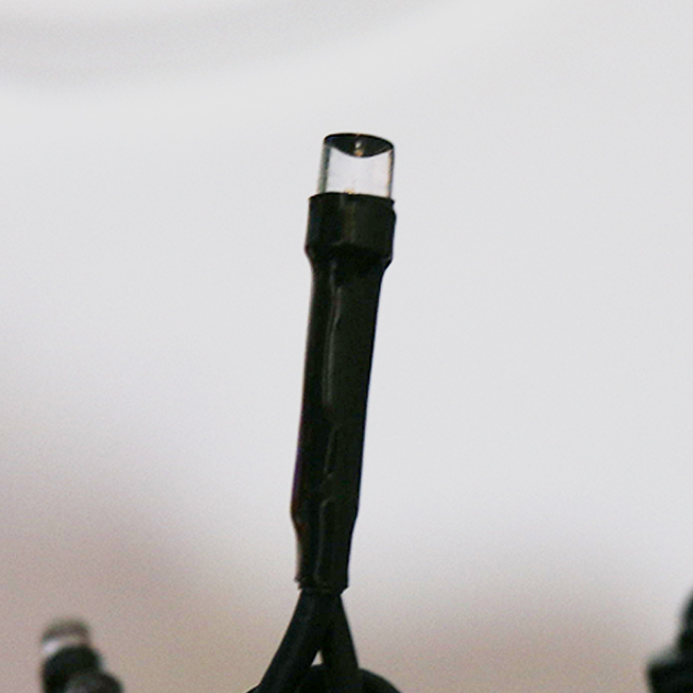
Faceted C7&C9
T-25B/1F-C7
T-25B/1F-C9

Slide 10
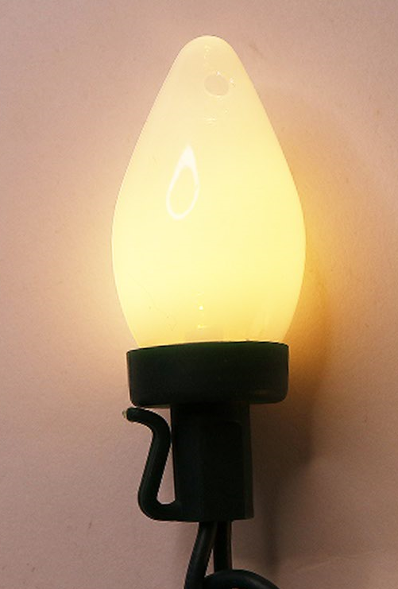
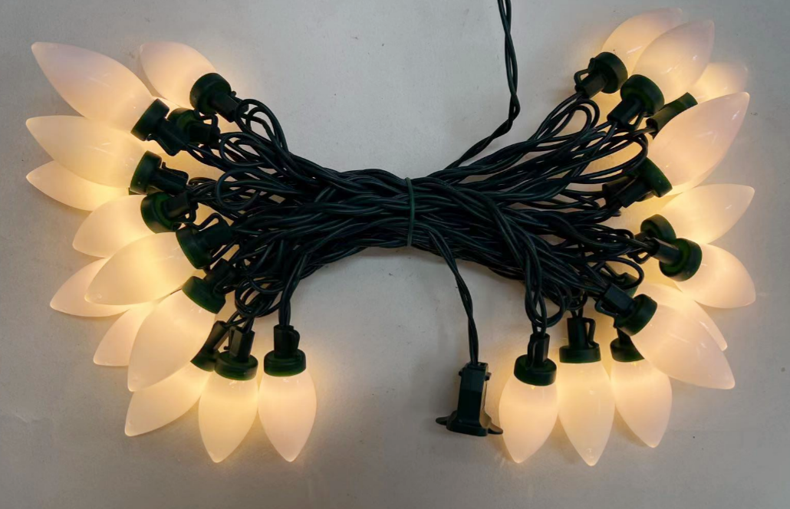
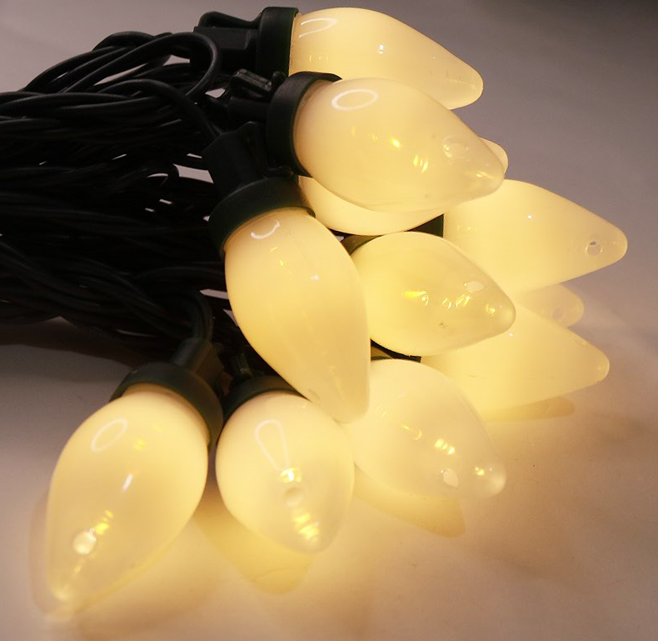
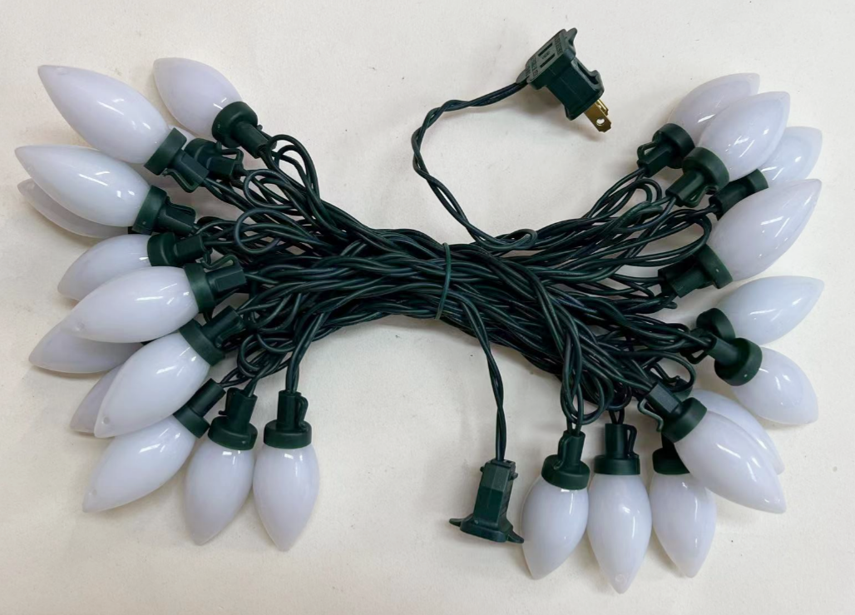
Ceramic C7/C9
T-25B/1F-C7M
T-25B/1F-C9M

Slide 11
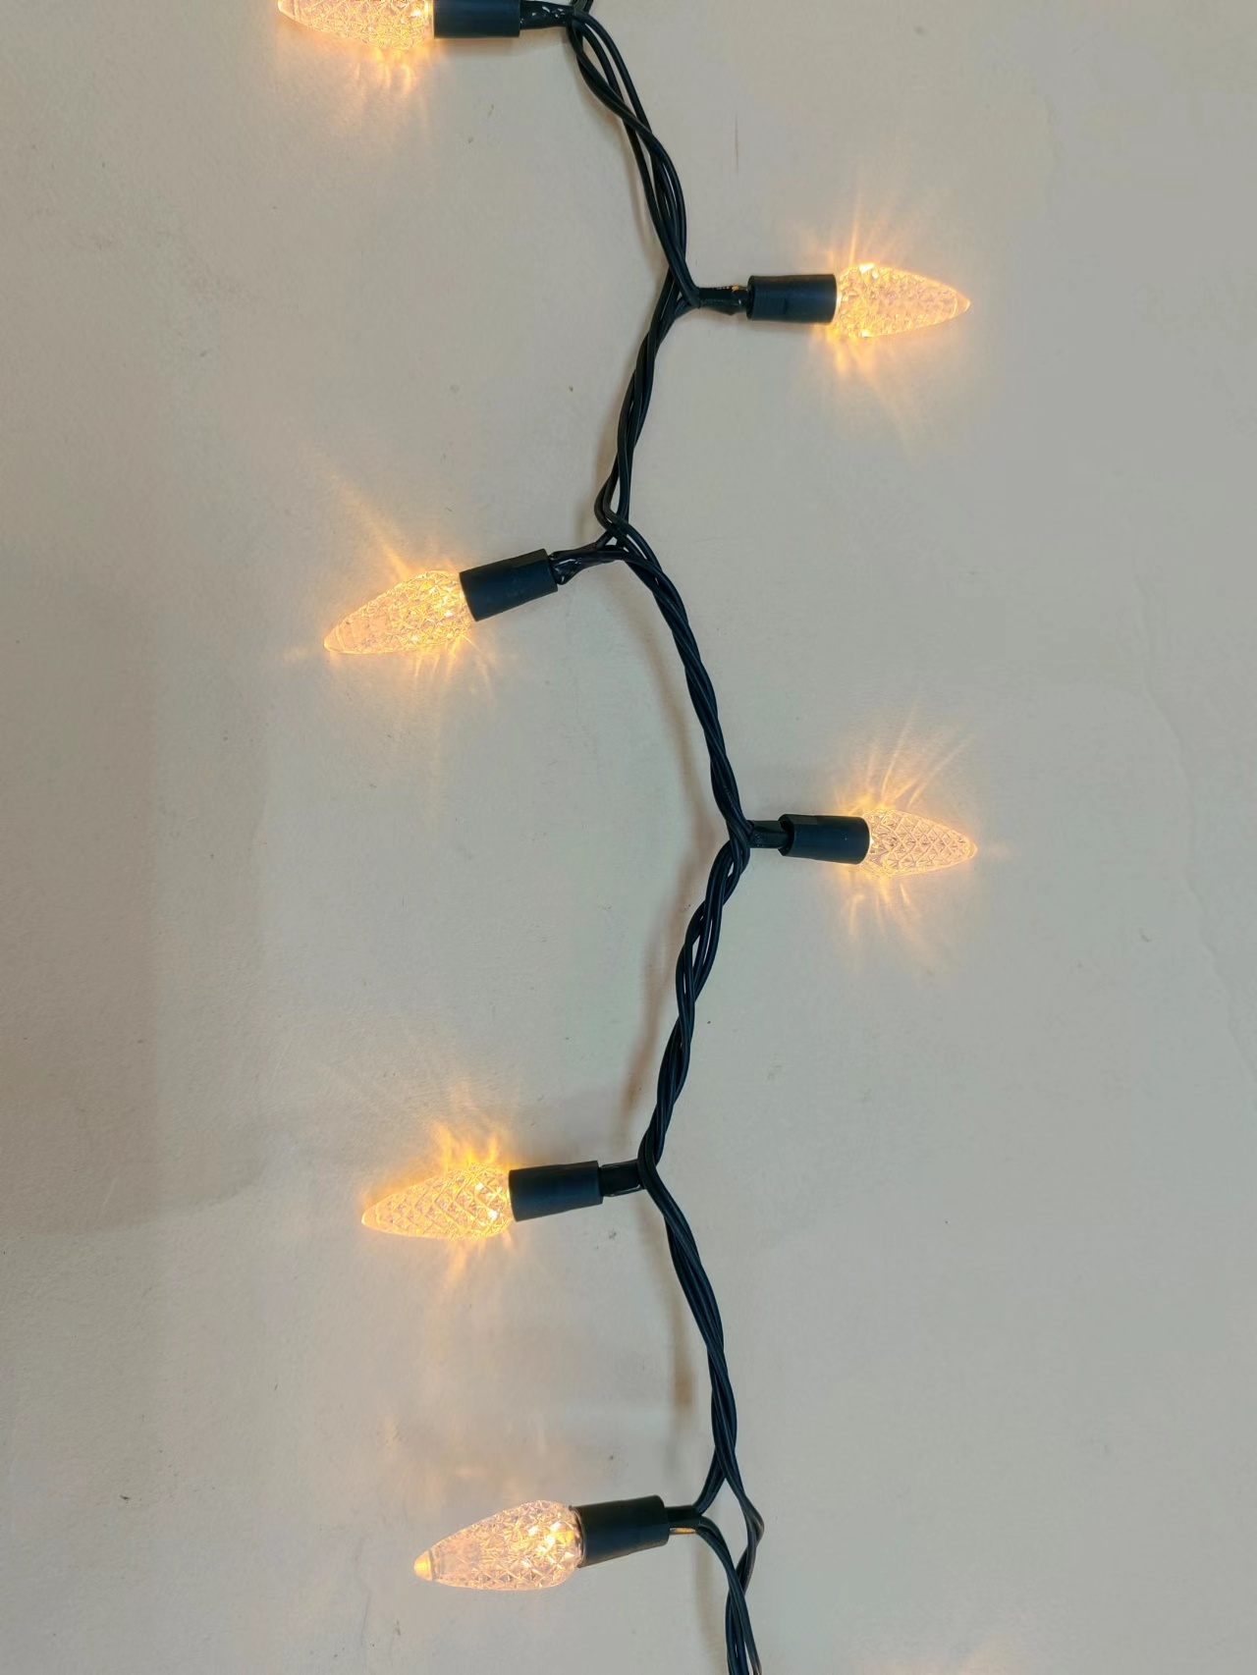
200lt led STRING LIGHTS
LED Color: White or Multi
LED Size: 3MM or 5MM Concave
Wire Color: Green, White
LEDs: 200
LED spacing:2.5”(6.35cm)
Lead in/out: 24”(60cm)/4”(10cm)
IP44,Ind&Outdoor use
Max connect end to end 3 sets
Adaptor
Steady On or w/Functions

Slide 12
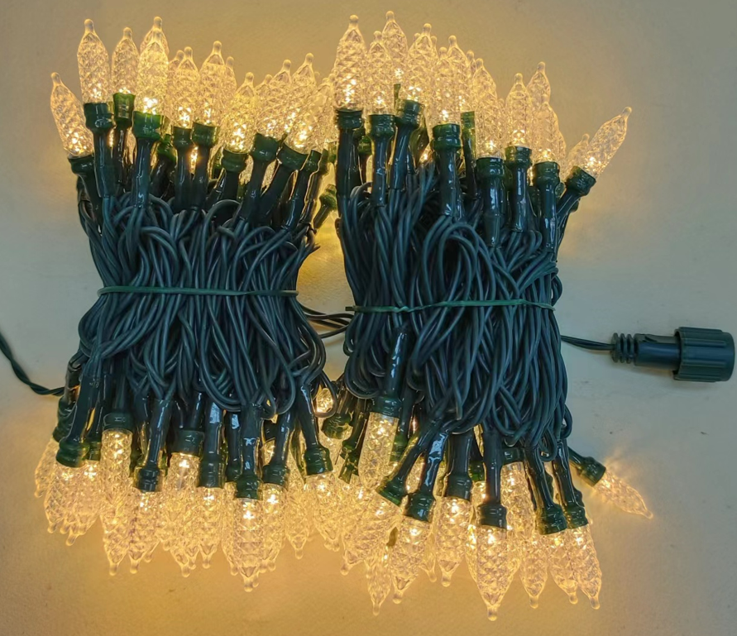
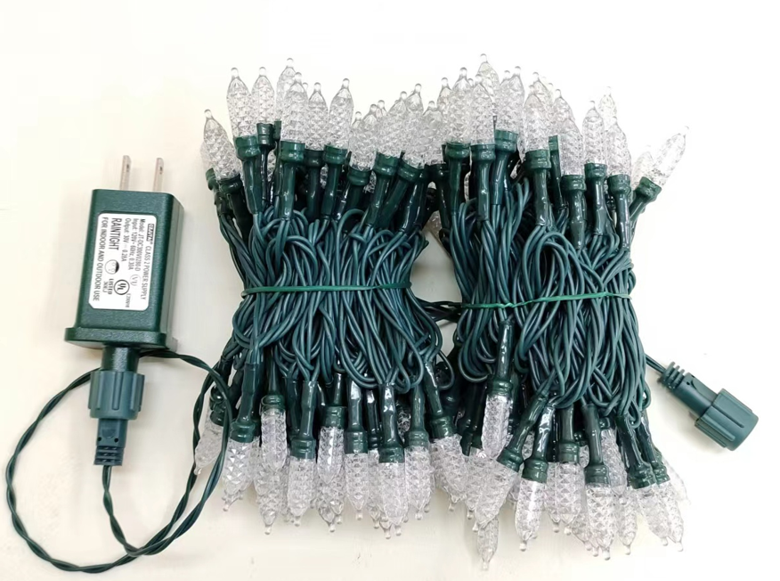
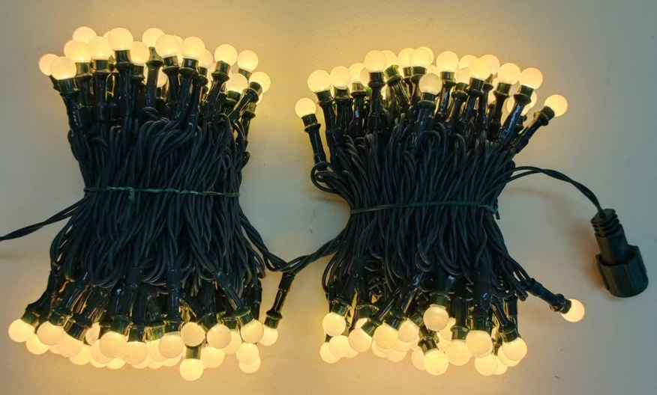
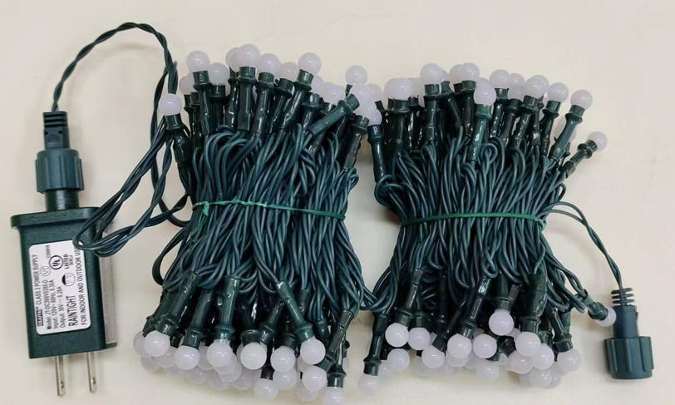
200LT LED String Lights
Steady On
TLV-200-7mm-WW
TLV-200-G8.8-WW

Slide 13
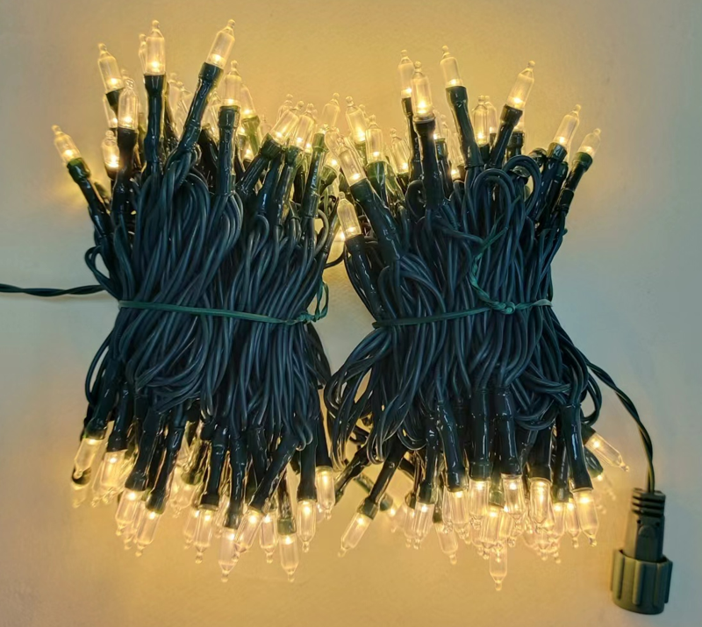
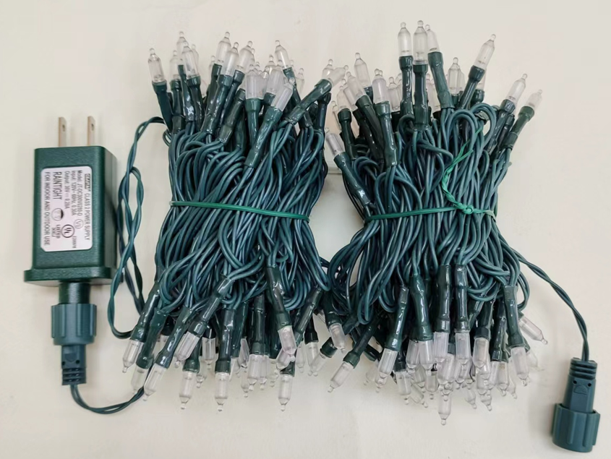
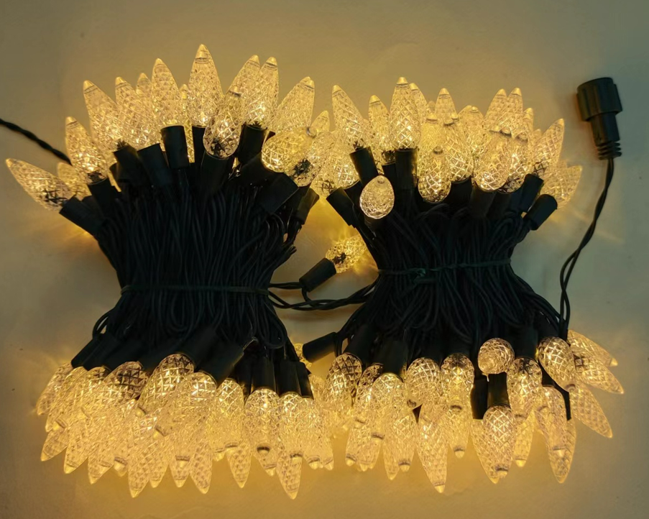
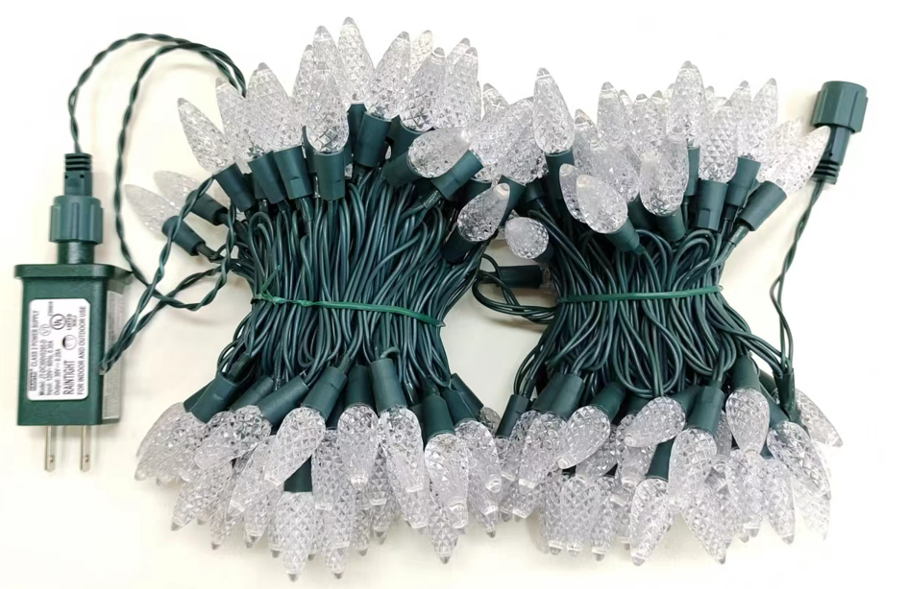
200LT LED String Lights
Steady On
TLV-200-A45-WW
TLV-200-C6-WW

Slide 14
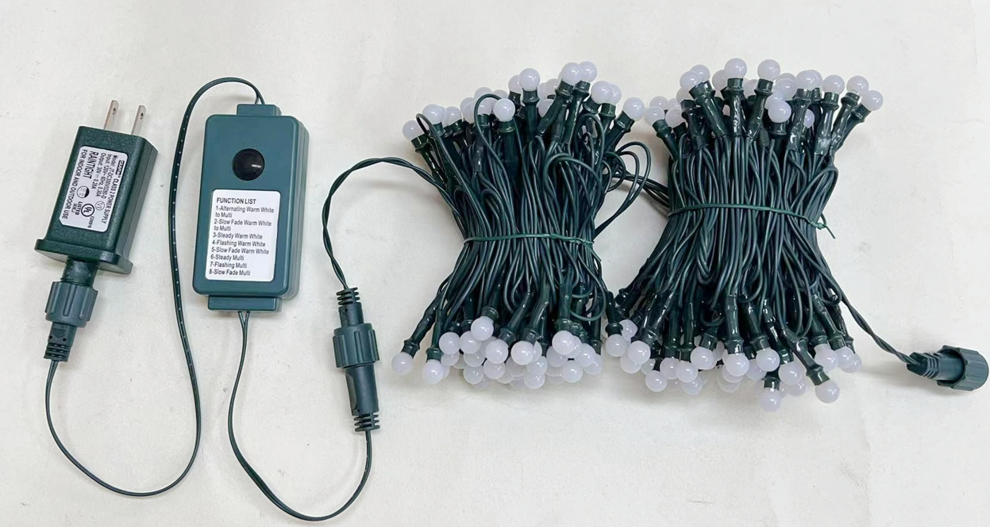
200LT LED String Lights
Bicolor LED, 9 Functions controller
TLV-200-G8.8-D

Slide 15
200LT LED String Lights
Bicolor LED, 9 Functions controller
TLV-200-7MM-D

Slide 16
200LT LED String Lights
Bicolor with Twinkle, 7 Functions controller
TLV-200-7MM-D+F

Slide 17
200LT LED String Lights
Bicolor with Twinkle, 7 Functions controller
TLV-200-G8.8-D+F

Slide 18
300lt led garland LIGHTS
LED Color: White or Multi
LED Size: 3MM or 5MM Concave
Wire Color: Green, White
LEDs: 300
LED spacing:1”(2.54cm)
Drop length: 1.5”(3.81cm)
Lead in/out: 24”(60cm)/4”(10cm)
IP44,Ind&Outdoor use
Max connect end to end 3 sets
Adaptor
Steady On or w/Functions

Slide 19
300LT LED Garland Lights
Steady On
TGLV-300-A45-WW
TGLV-300-G8.8-WW
TGLV-300-7mm-M

Slide 20
300LT LED Garland Lights
Bicolor LED, 9 Functions controller
TGLV-300-G8.8-D

Slide 21
300LT LED Garland Lights
Bicolor LED, 9 Functions controller
TGLV-300-7MM-D

Slide 22
300LT LED Garland Lights
Bicolor LED, 9 Functions controller
TGLV-300-A45-D

Slide 23
300LT LED Garland Lights
Bicolor with Twinkle, 7 Functions controller
TGLV-300-G8.8-D+F

Slide 24
300LT LED Garland Lights
Bicolor with Twinkle, 7 Functions controller
TGLV-300-7MM-D+F

Slide 25
300LT LED Garland Lights
Bicolor with Twinkle, 7 Functions controller
TGLV-300-A45-D+F

Slide 26
300lt led icicle LIGHTS
LED Color: White or Multi
LED Size: 3MM or 5MM Concave
Wire Color: White
LEDs: 300
LED spacing:3”(7.62cm)
Drop spacing: 4”(10cm)
Lead in/out: 24”(60cm)/4”(10cm)
IP44,Ind&Outdoor use
Max connect end to end 3 sets
Adaptor
Steady On or w/Functions

Slide 27
300LT LED Icicle Lights
Steady On
TILV-300-7MM-WW

Slide 28
300LT LED Icicle Lights
Steady On
TILV-300-A45-WW

Slide 29
300LT LED Icicle Lights
Bicolor LED, 9 Functions controller
TILV-300-7MM-D

Slide 30
300LT LED Icicle Lights
Bicolor LED, 9 Functions controller
TILV-300-A45-D

Slide 31
300LT LED Icicle Lights
Bicolor LED with Twinkle, 7 Functions controller
TILV-300-7MM-D+F

Slide 32
300LT LED Icicle Lights
Bicolor LED with Twinkle, 7 Functions controller
TILV-300-A45-D+F

Slide 33
specification
LED Color: White or Multi
LED Size: 3MM or 5MM Concave
Wire Color: White or Green
LEDs: 50,100,200,300 or 500
LED spacing:4”(10cm)
Lead wire: 2M lead Wire
IP44,Ind&Outdoor use
Solar or Battery Box
On/Off or 8 Functions, timer

