Slide 1
Decorative Light Strings

Slide 2
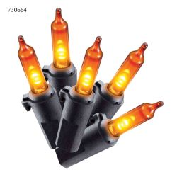
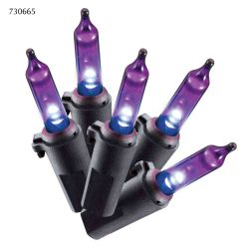
LED SMOOTH MINI
UL 120V 60LT LED SMOOTH MINI, ORANGE COVER, ORANGE LED, IND/OUT, BLACK WIRE, END CONNECT,24”LEAD IN,4” BULB SPACING,4”LEAD OUT
UL 120V 60LT LED SMOOTH MINI, PURPLE COVER, PURPLE LED, IND/OUT, BLACK WIRE, END CONNECT
24”LEAD IN,4” BULB SPACING,4”LEAD OUT

Slide 3
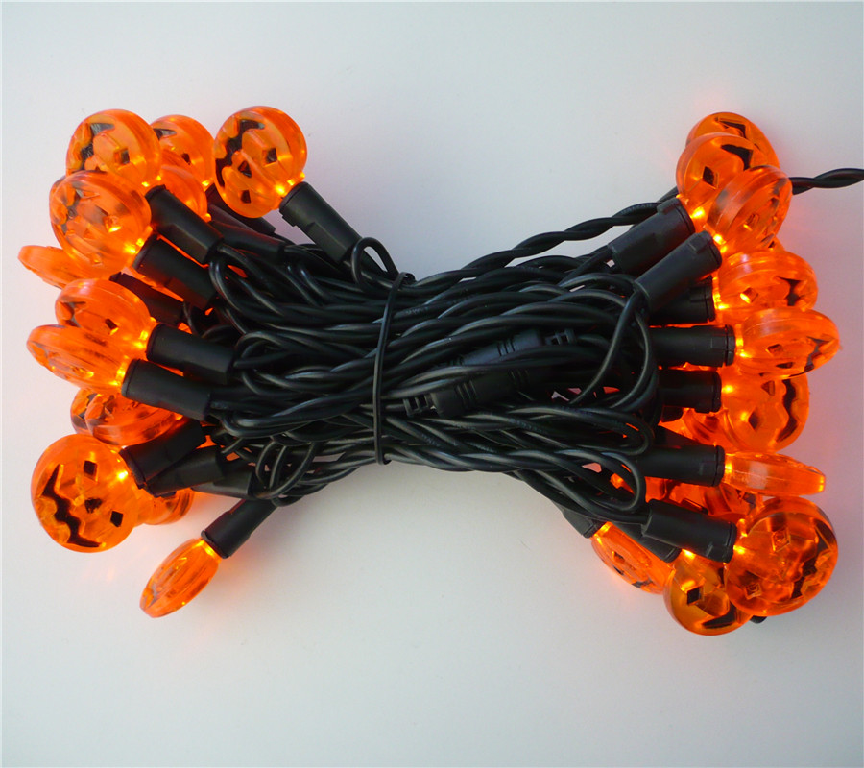
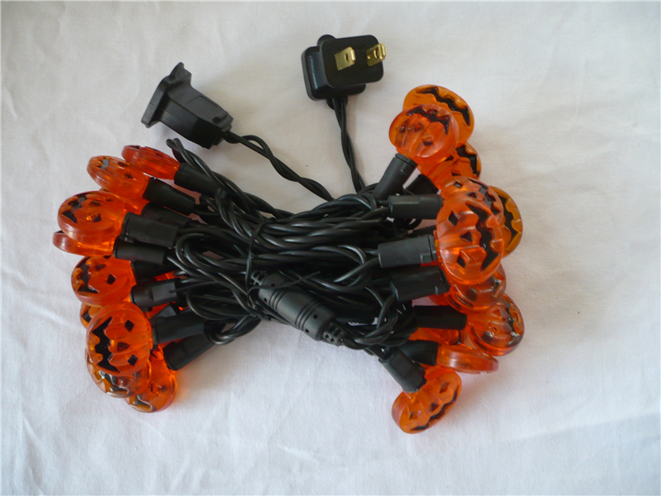
LED Pumpkin Face- H5109A
UL 120V 35 ct LED orange with pumpkin face cover string lights , black wire, Lead cord 12”,bulb spacing 4”,tail cord 4”,light length 11.3ft,total length12.6ft

Slide 4
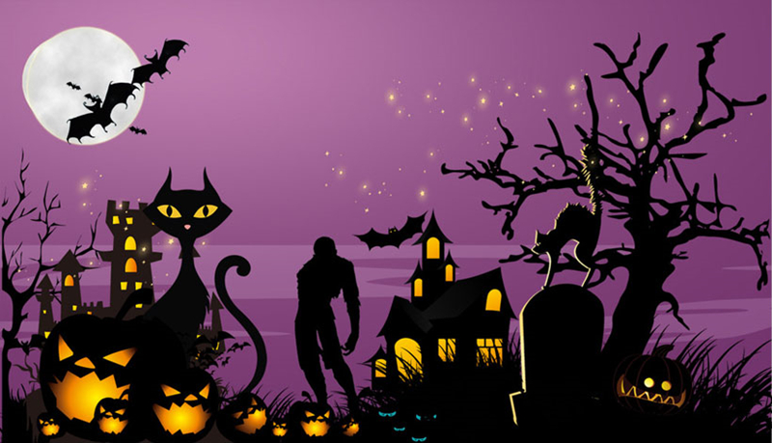
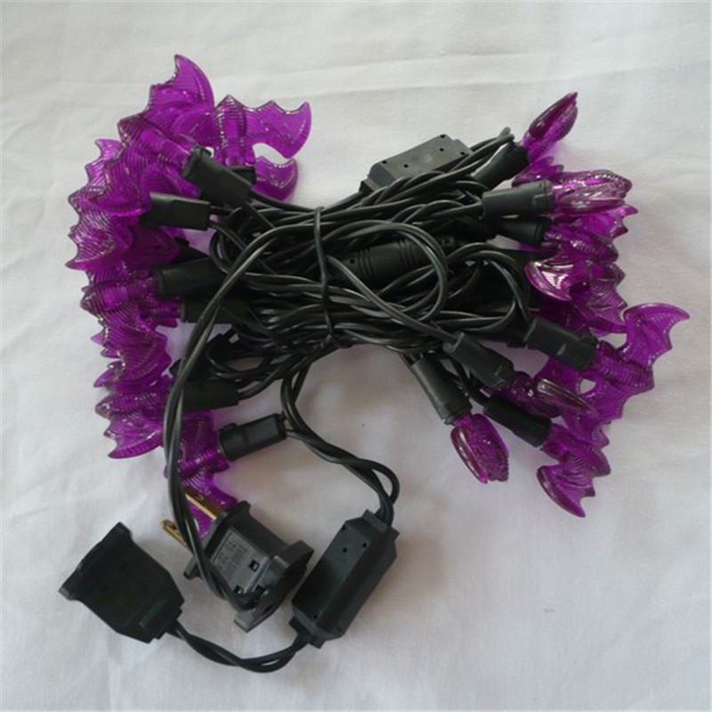
LED Bat- H5109B
UL120V 35 ct LED purple with bat cover string lights , black wire,
Lead cord 12”,bulb spacing 4”,tail cord 4”,light length 11.3ft,total length12.6ft

Slide 5
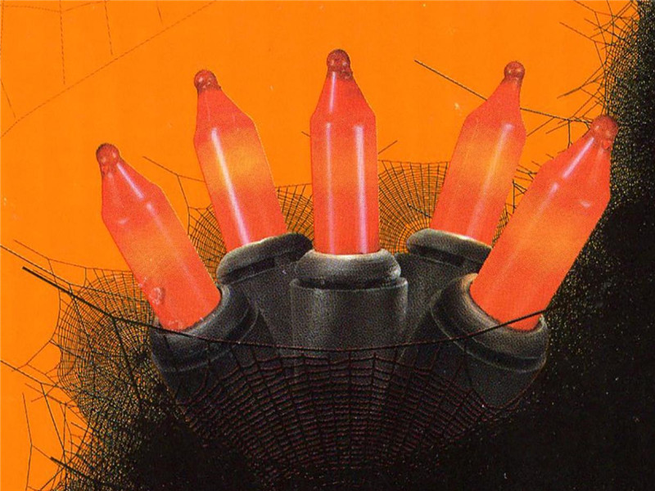
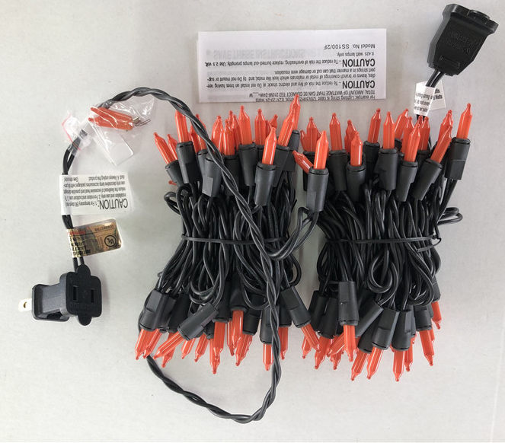
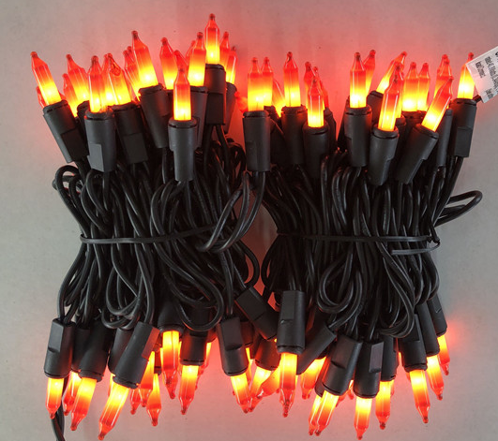
Orange light- H5119A
UL120V 100ct incandescent mini string lights , black wire, orange bulb,Lead cord 24”,bulb spacing 2.25”,tail cord 4”,light length 18.5ft,total length20.8ft

Slide 6
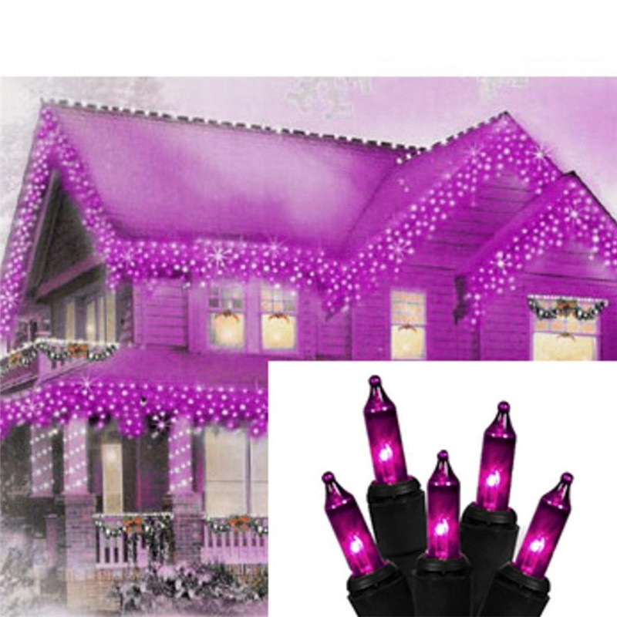
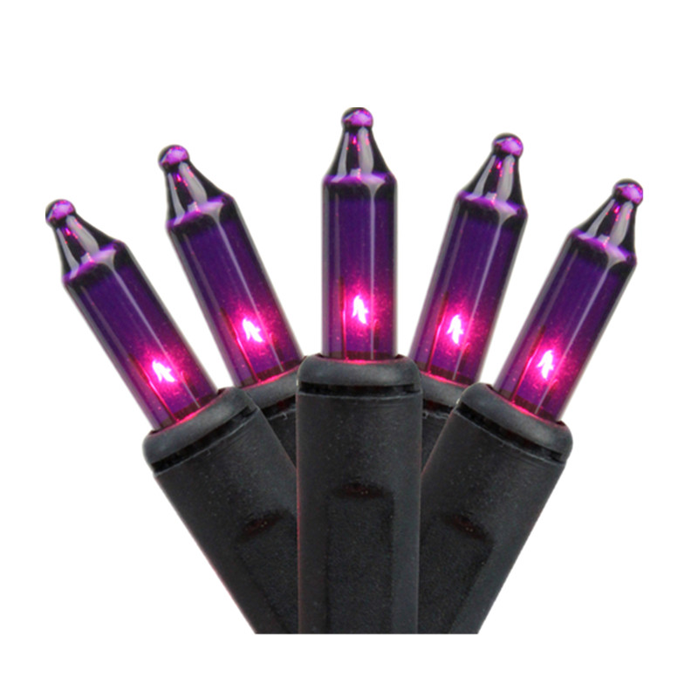
Purple light- H5119B
UL 120V 100ct incandescent mini string lights , black wire, purple bulb,Lead cord 24”,bulb spacing 2.25”,tail cord 4”,light length 18.5ft,total length20.8ft

Slide 7
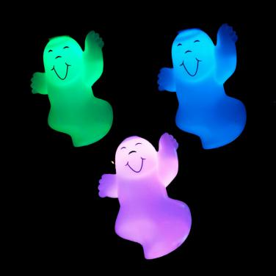
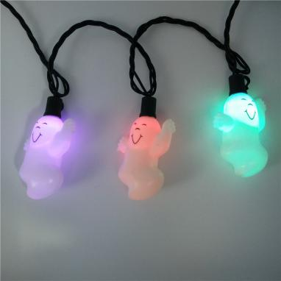
Halloween Lights-ghost- H5101
10 ct LED color change with ghost string lights , black wire,
Lead cord 60cm,bulb spacing 20cm,tail cord 15cm,light length 1.8m,total length2.55m

Slide 8
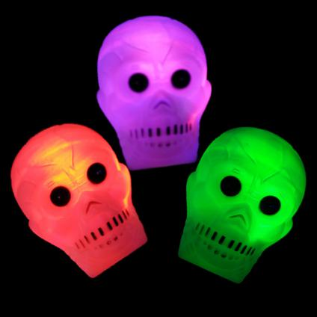
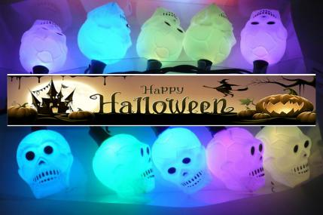
Halloween Lights-skull-H5102
10 ct LED color change with skull string lights , black wire,
Lead cord 60cm,bulb spacing 20cm,tail cord 15cm,light length 1.8m,total length2.55m

Slide 9
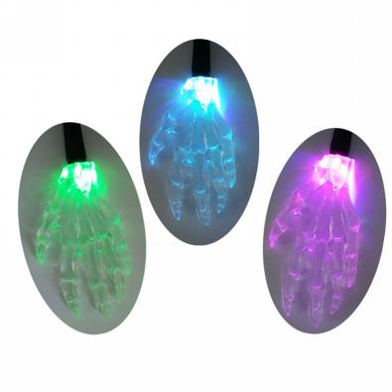
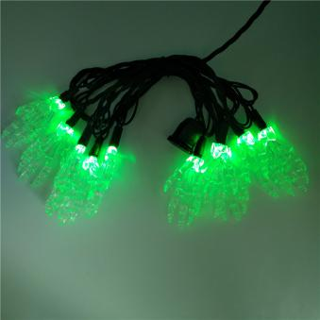
Halloween Lights-Skeleton hands-H5104
10 ct LED color change with skeleton hands string lights , black wire,
Lead cord 60cm,bulb spacing 20cm,tail cord 15cm,light length 1.8m,total length2.55m

Slide 10
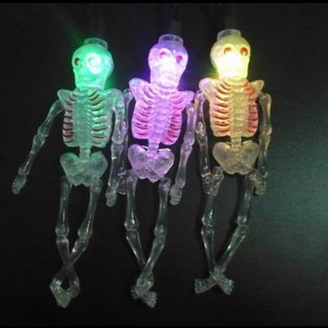
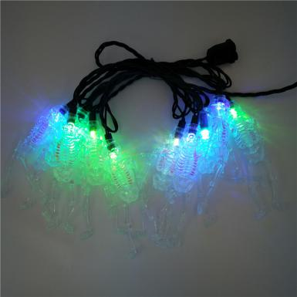
Halloween Lights-Skeleton-H5106
10 ct LED color change with skeleton hands string lights , black wire,
Lead cord 60cm,bulb spacing 20cm,tail cord 15cm,light length 1.8m,total length2.55m

Slide 11
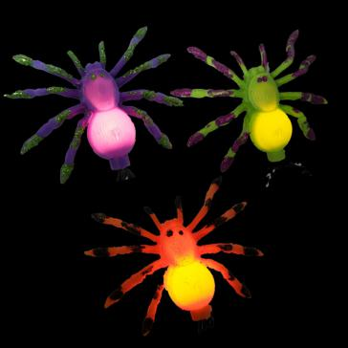
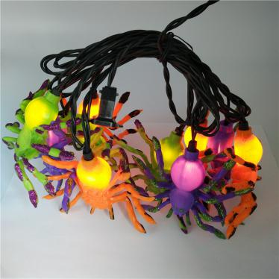
Halloween Lights-Spider-H5103
10 ct mini multi color with spider string lights , black wire,
Lead cord 60cm,bulb spacing 20cm,tail cord 15cm,light length 1.8m,total length2.55m

Slide 12
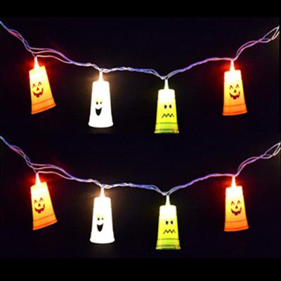
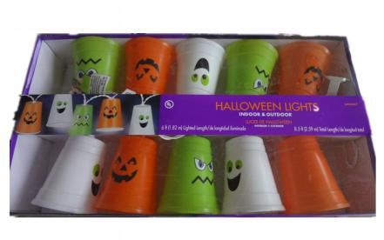
Halloween Lights-Cup-H5105
10 ct mini clear with multi color 9”cup string lights , white wire,
Lead cord 60cm,bulb spacing 20cm,tail cord 15cm,light length 1.8m,total length2.55m

Slide 13
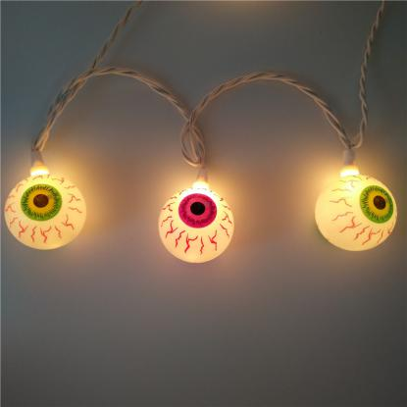
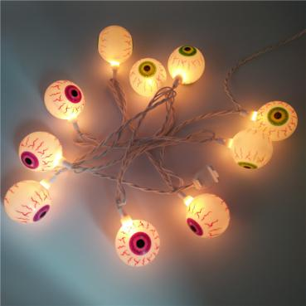
Halloween Lights-Eyeball-H5112
10 ct mini clear with multi color eyeball string lights , white wire,
Lead cord 60cm,bulb spacing 20cm,tail cord 15cm,light length 1.8m,total length2.55m

Slide 14
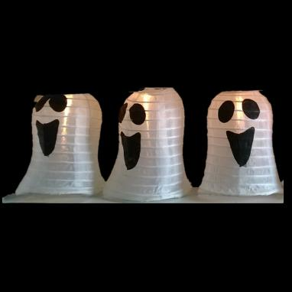
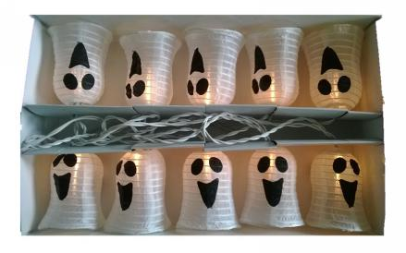
Halloween Lights-ghost lantern-H5113
10 ct mini clear with ghost lantern string lights , white wire,
Lead cord 60cm,bulb spacing 20cm,tail cord 15cm,light length 1.8m,total length2.55m

Slide 15
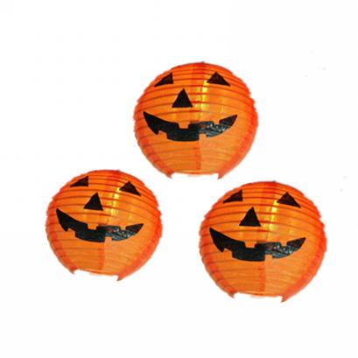
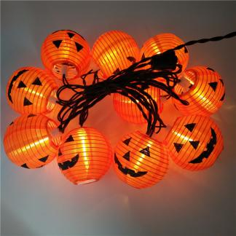
Halloween Lights-pumpkin lantern-H5114
10 ct mini clear with pumpkin lantern string lights , black wire,
Lead cord 60cm,bulb spacing 20cm,tail cord 15cm,light length 1.8m,total length2.55m

Slide 16
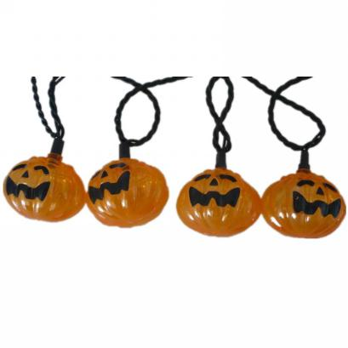
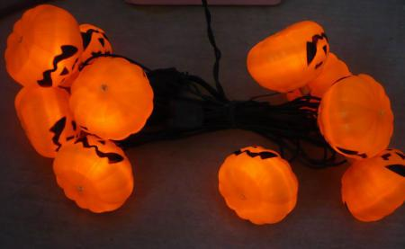
Halloween Lights-pumpkin -H5115
10 ct mini clear with pumpkin lantern string lights , black wire,
Lead cord 60cm,bulb spacing 20cm,tail cord 15cm,light length 1.8m,total length2.55m

Slide 17
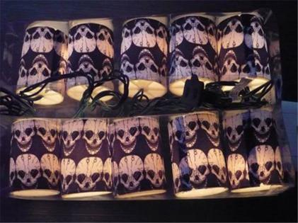
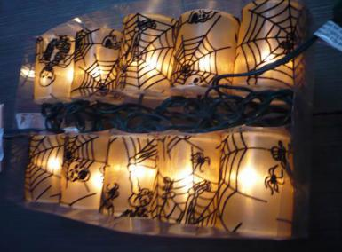
Halloween Lights-lantern -H5117
10 ct mini clear with lantern string lights , black wire,
Lead cord 60cm,bulb spacing 20cm,tail cord 15cm,light length 1.8m,total length2.55m

Slide 18
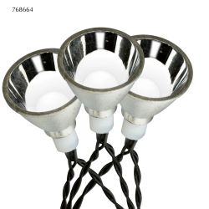
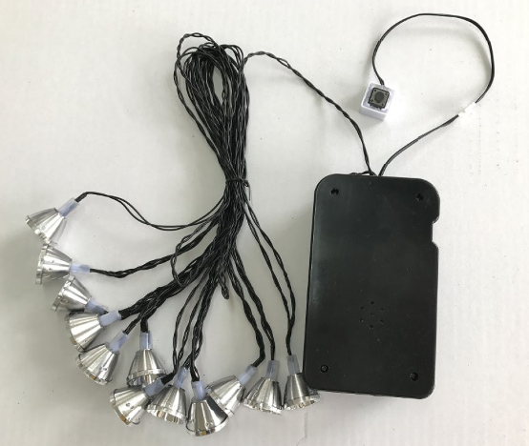
BO LED Strobe Lights-H5108
B/O 12LT SOUND & MOTION ACTIVATED LED STROBE LIGHT WITH SOUND, COOL WHITE LED, INDOOR ONLY, UL 26# BLACK WIRE, 48" LEAD, 18" SPACING, REQ 3AA BATTERIES WITH SENSOR, BATTERY NOT INCL, TRY ME.

Slide 19
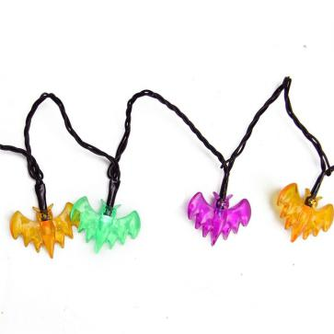
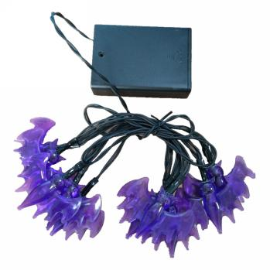
BO Halloween Lights-bat -H5120
Battery Operated 10 ct LED with bat string lights , black wire,
Lead cord 60cm,bulb spacing 10cm, light length 0.9m,total length1.5m

Slide 20
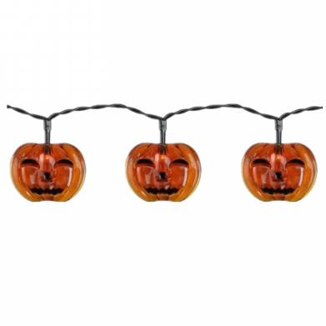
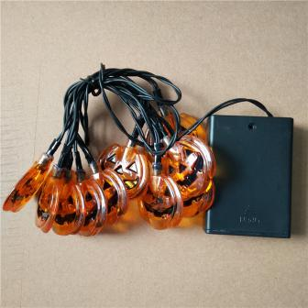
BO Halloween Lights-pumpkin face -H5121
Battery Operated 10 ct LED with pumpkin face string lights , black wire,
Lead cord 60cm,bulb spacing 10cm, light length 0.9m,total length1.5m

Slide 21
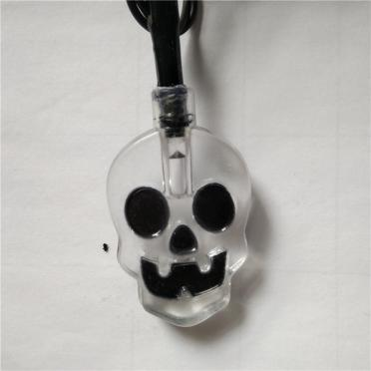
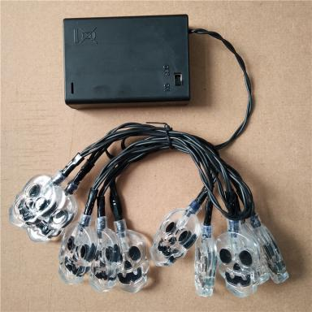
BO Halloween Lights-skull -H5123
Battery Operated 10 ct LED with skull string lights , black wire,
Lead cord 60cm,bulb spacing 10cm, light length 0.9m,total length1.5m

Slide 22
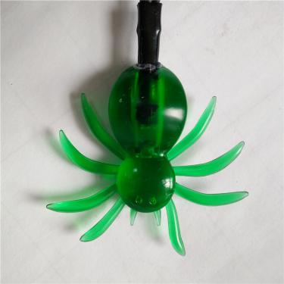
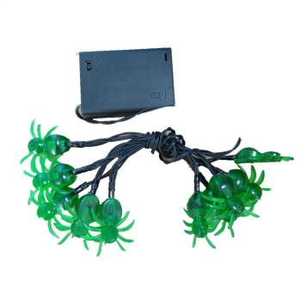
BO Halloween Lights-spider-H5122
Battery Operated 10 ct LED with spider string lights , black wire,
Lead cord 60cm,bulb spacing 10cm, light length 0.9m,total length1.5m

Slide 23
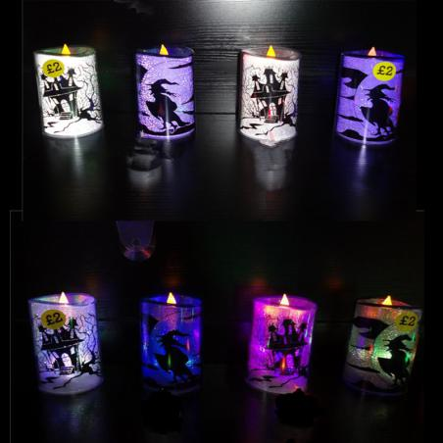
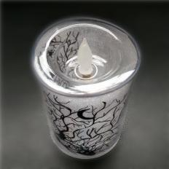
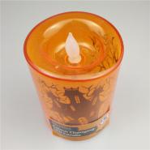
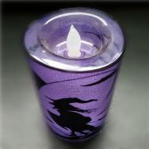
BO Halloween Lights-Candle-H5130
Battery Operated LED candle with Halloween elements ,size: dia.8.2cm, h12cm,3AA battery box

Slide 24
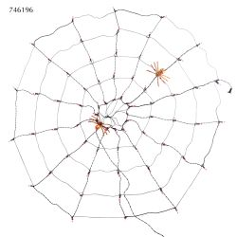
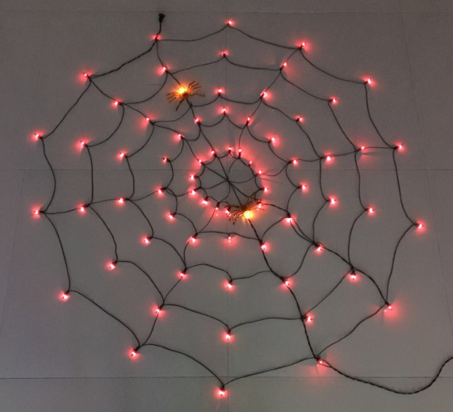
BO Halloween Lights-Candle-H5130
70LT 60"D SPIDER WEB WITH 2 SPIDERS, PURPLE AND ORANGE BULBS, ORANGE SPIDERS, IND/OUT, BLACK WIRE, END CONNECT, 4 SUCTION CUPS INCL

Slide 25
Pathway markers

Slide 26
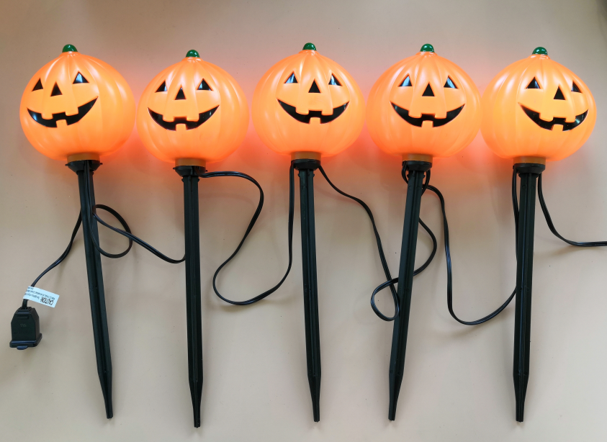
Halloween Garden&Lawn
UL pumpkin Stake Lights with total with one Incandesent Clear C7(5W) Bulb in each stake w/end connect , -15" Stakes, 18”Lead in, 18”spacing , 6”end out.Indoor and outdoor use.

Slide 27
Halloween Garden&Lawn
UL Gost Stake Lights with total with one Incandesent Clear C7(5W) Bulb in each stake w/end connect , -18" Stakes, 18”Lead in, 18”spacing , 6”end out.Indoor and outdoor use.

Slide 28
Decorative Garlands

Slide 29
Halloween GARLAND Lights
200LT LED GARLAND LIGHTS,3MM LED WITH 40 TWINKLE BULBS,1” BULB SPACING,1.5” DROP SPACING,36” LEAD IN,16.5FT LIGHT LENGTH,UL ADAPTOR, NO END CONNECT,BLACK WIRE.

Slide 30
Icicle Lights

Slide 31
Halloween Icicle Lights-Incandescent
UL 120V 105LT ICICLE LIGHTS,MULTI COLOR, 20” LEAD IN,6” LEAD OUT,3” BULB SPACING,DROP SEQUENCE: 8-6-7-8-6-7,END CONNECT,IND&OUT USE

Slide 32
Halloween Icicle Lights-LED
UL 120V 105LT SMOOTH MINI ICICLE LIGHTS,MULTI LED(ORANGE/PURPLE), 20” LEAD IN,6” LEAD OUT,3” BULB SPACING,DROP SEQUENCE: 8-6-7-8-6-7,END CONNECT,IND&OUT USE

Slide 33
Hanging Decor

Slide 34
Halloween Motif Lights-spider net-H5124
16.5"H 35LT SPIDER WEB WINDOW DEC, BLACK PLASTIC FRAME, ORANGE AND PURPLE LED, IND/OUT, BLACK WIRE, STRAIGHT LINE, 2 SUCTION CUPS INCL

Slide 35
Halloween Motif Lights-Pumpkin-H5125
15.75"H 35LT JACK-O-LANTERN WINDOW DEC, ORANGE PLASTIC FRAME, ORANGE AND GREEN LED, IND/OUT, ORANGE WIRE, STRAIGHT LINE, 2 SUCTION CUPS INCL

Slide 36
Halloween Motif Lights-Bat-H5126
13.25"H 35LT BLACK BAT WINDOW DEC, BLACK PLASTIC FRAME, ORANGE AND PURPLE LED, IND/OUT, BLACK WIRE, STRAIGHT LINE, 2 SUCTION CUPS INCL

Slide 37
Halloween Motif Lights-Skull-H5127
Low voltage 156ct LED rope tube lihgts,cool white led,ferric skull size:wxh=28x45cm, Lead cord 120cm, adapter:28V3W

Slide 38
Halloween Motif Lights-Pumpkin-H5128
Low voltage 157ct LED rope tube lihgts,orange led,ferric pumpkin size:wxh=40x45cm, Lead cord 120cm, adapter:28V3W

Slide 39
Halloween Motif Lights-Bat-H5129
Low voltage 100ct LED rope tube lihgts,purple led,ferric bat size:wxh=60x22cm, Lead cord 120cm, adapter:28V3W

Slide 40
Halloween Motif Lights
Motif with PVC cooper wire Lights
39cm
39cm
48cm

Slide 41
Neon Rope Motif

Slide 42
Halloween Motif Lights-Bat-H5130
LV 18" LED Neon(single side) Bat Light,With UL 24V/8W Adaptor, 72" lead wire,Purple LED

Slide 43
Halloween Motif Lights-Pumpkin-H5131
13" LED Neon(single side) Pumpkin Light,With UL 29V/8W Adaptor, 72" lead wire,Orange LED

Slide 44
Halloween Motif Lights-Ghost-H5132
LV 15" LED Neon(single side) Ghost Light,With UL 24V/8W Adaptor 72" lead wire,PW

Slide 45
Halloween Motif Lights-BOO-H5133
20" LED Neon(single side) "BOO" Light，With UL 24V/8W Adaptor, 72" lead wire,Orange LED

